Slide 1


BOOTCAMP TRAINING – IDA
WEEK 5 REPORT
-Neha Juyal

Slide 2
Day 1 – Azure Synapse Analytics
Followings were the learning of Day- 1:
Introduction of SQL Data Warehouse
Azure Synapse Mapping Data Flow
Pipeline
Data Ingestion and Preparation
Analysis of data using SQL

Slide 3
Day – 2 Power BI
Followings were the learning of Day-2:
Exploration of Power BI and its interface
Data Source Connection (CSV, Excel)
Data Loading and Transformation
Eliminating duplicates , Removing errors and blank spaces
Slicers
Handling dates

Slide 4
Day 3 – Power BI
Followings were the learning of Day-3:
Removing duplicate values
Removing errors
DAX & Calculated Columns
Measures
Aggregation functions
Reports and Dashboards in Power BI

Slide 5
Day – 4 Python
Followings were the learning of Day-4:
Data types in Python
Boolean values
Arithmetic Operators
Logical Operators
Zip() function
Enumerate() function
Range() function
Hands-on assessment

Slide 6
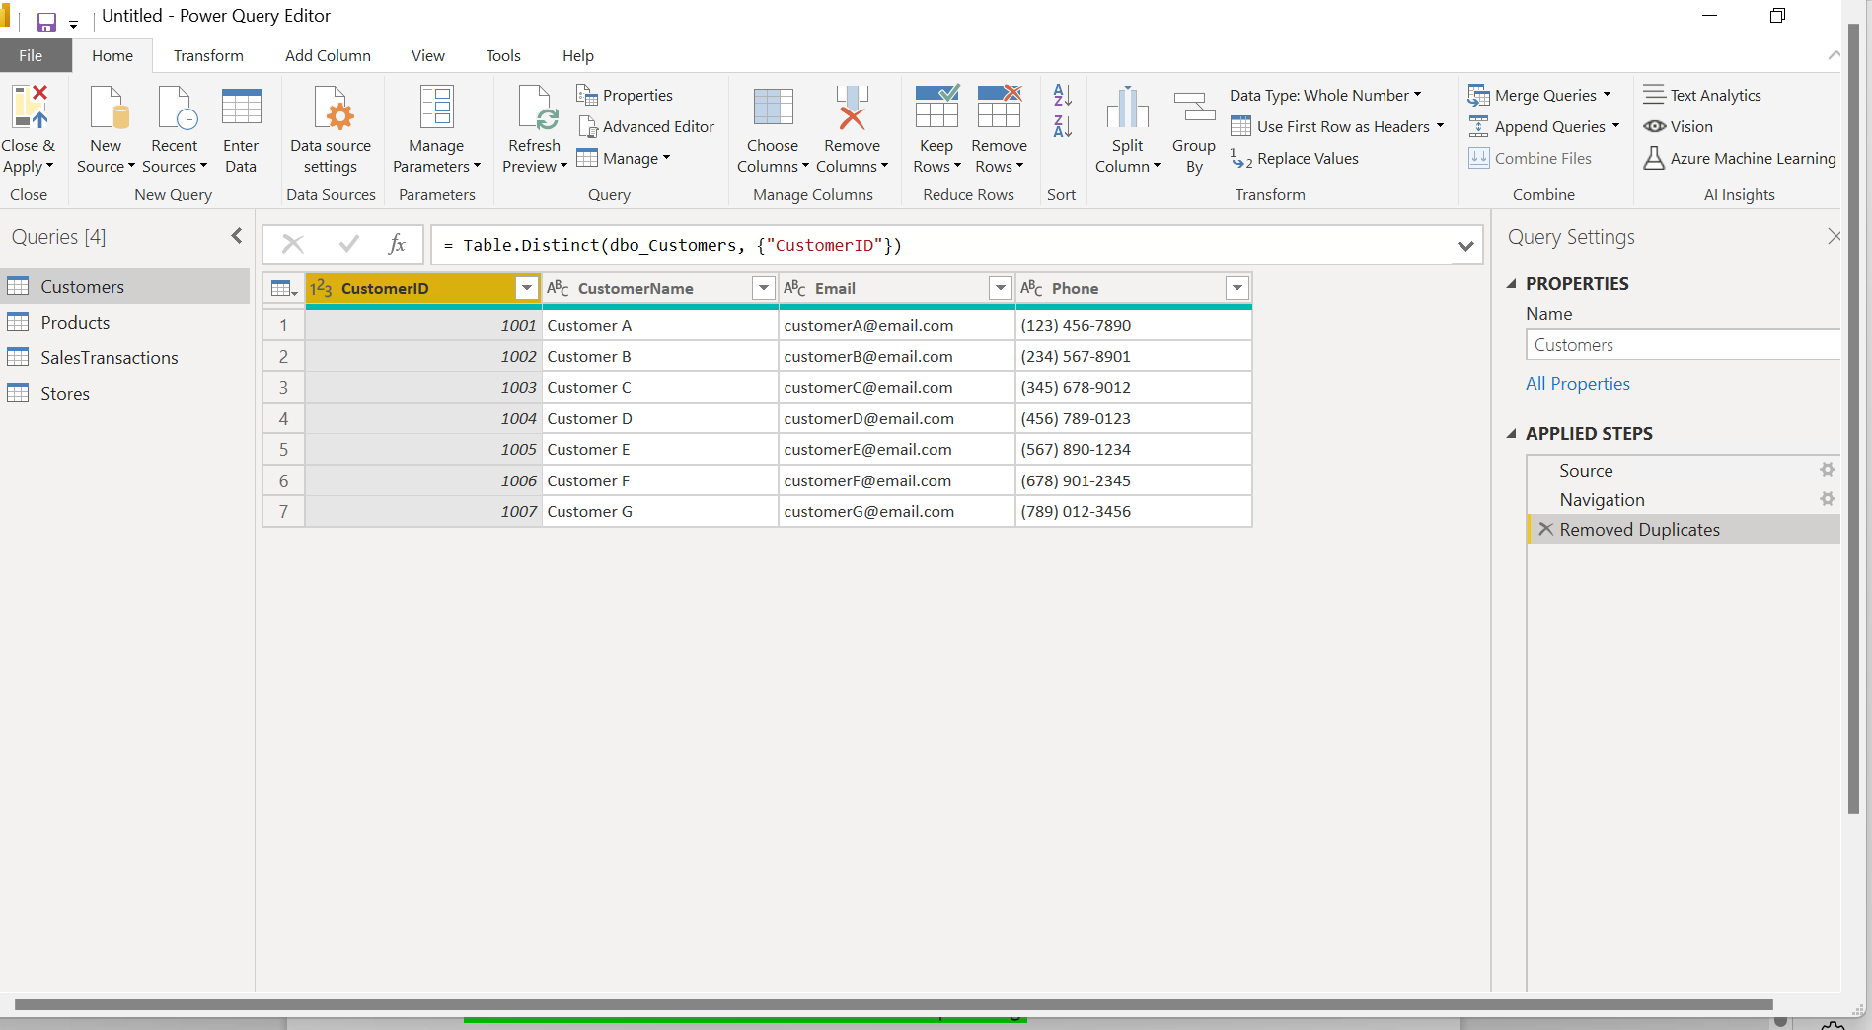

Slide 7
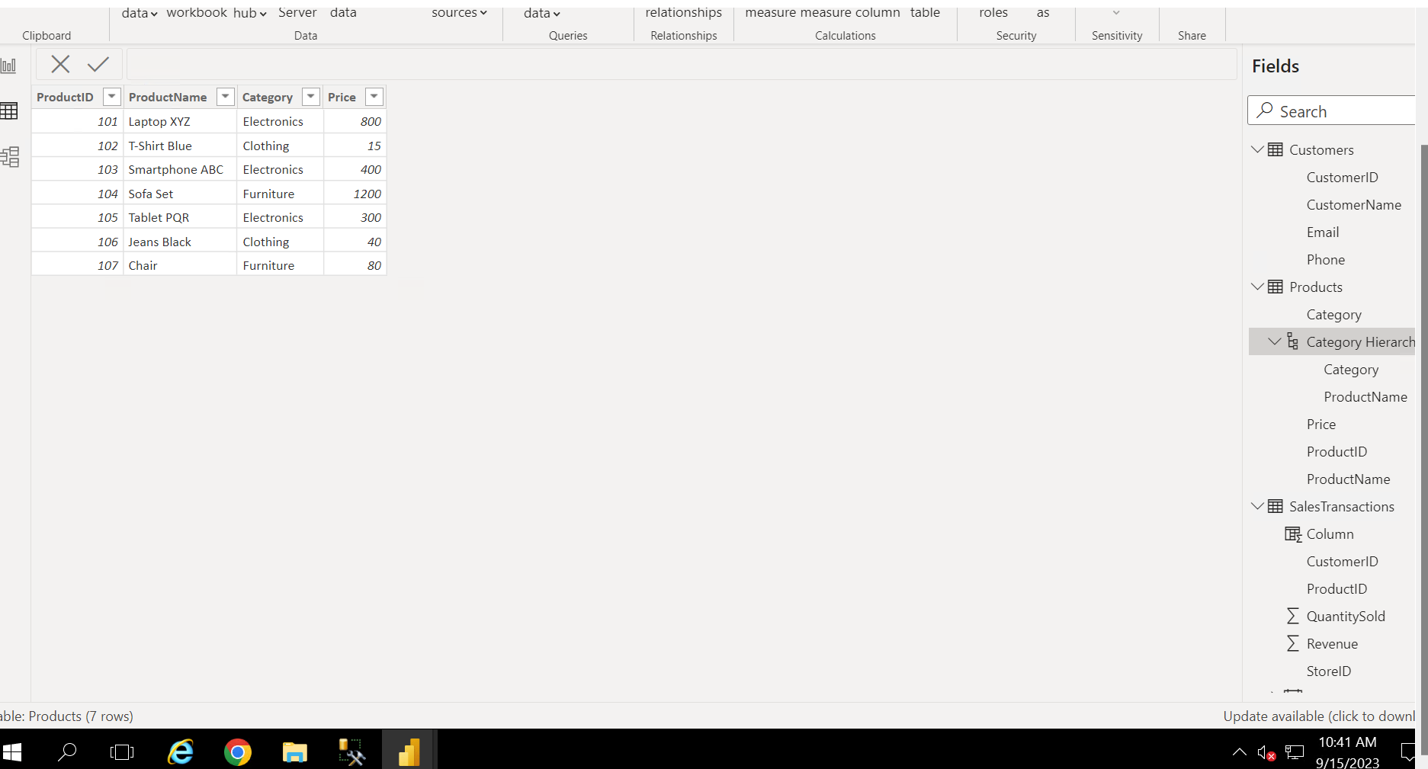

Slide 8
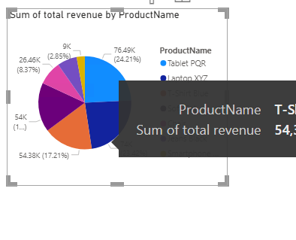

Slide 9
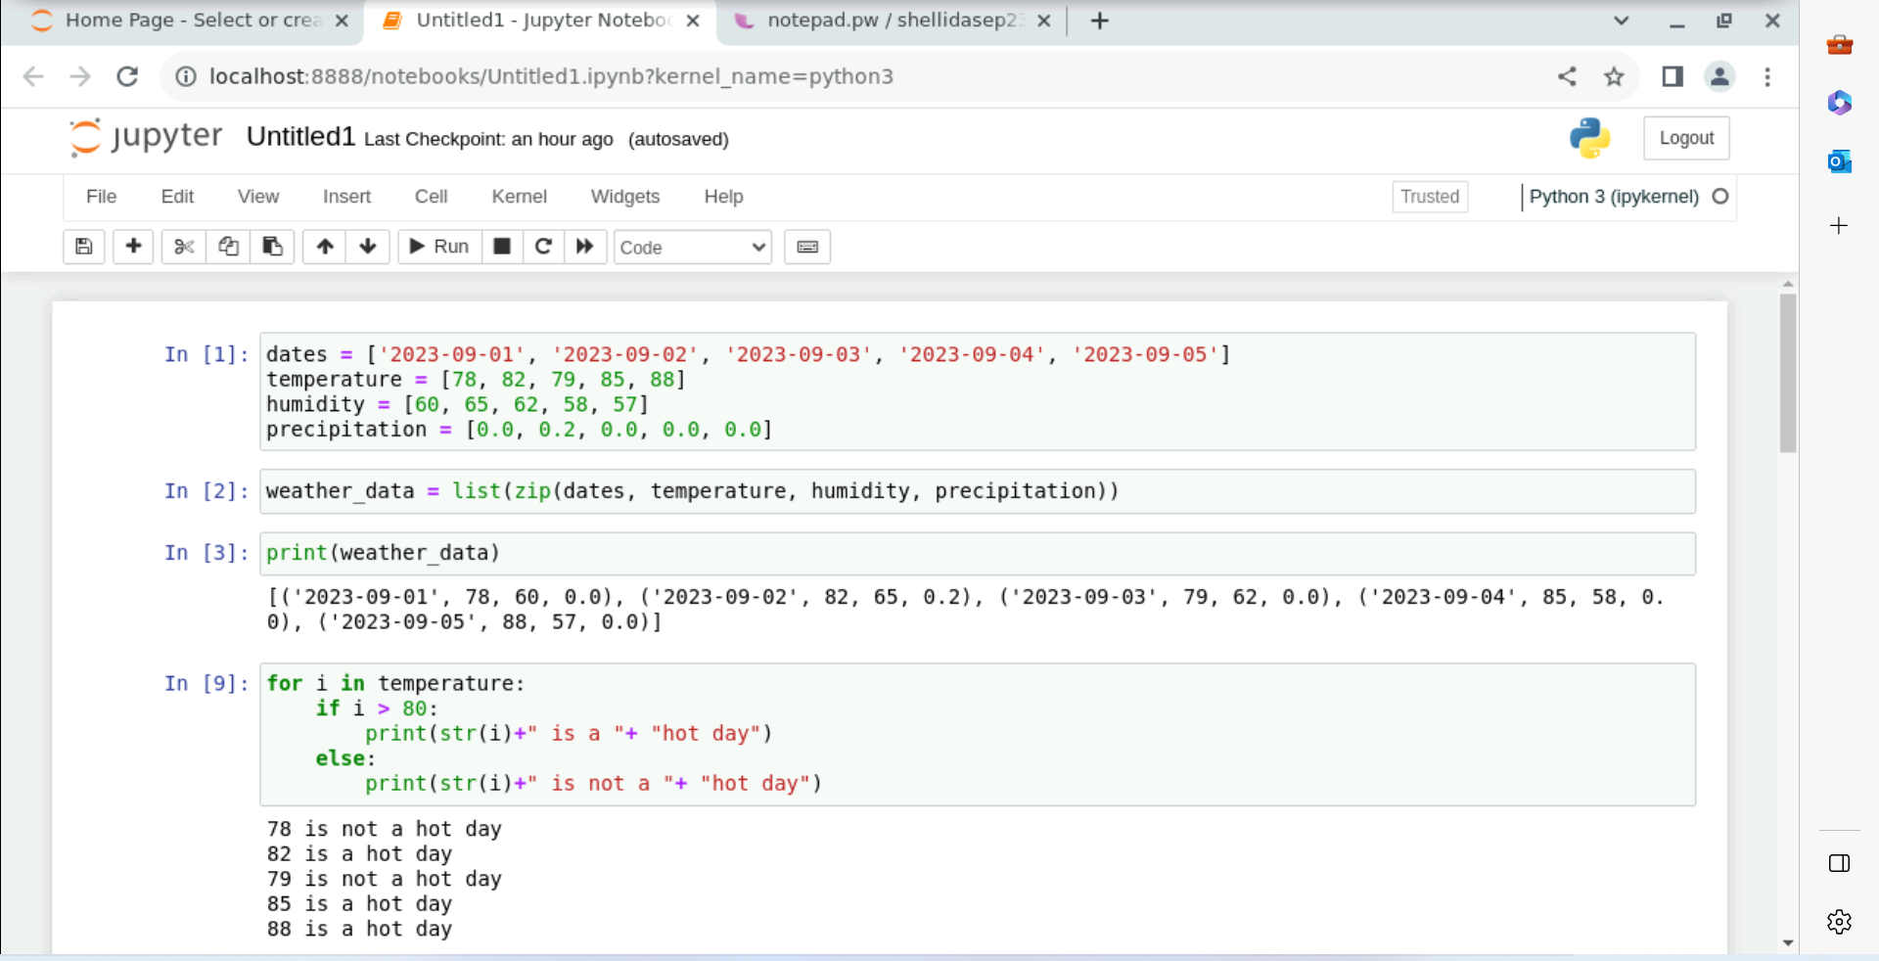

Slide 10
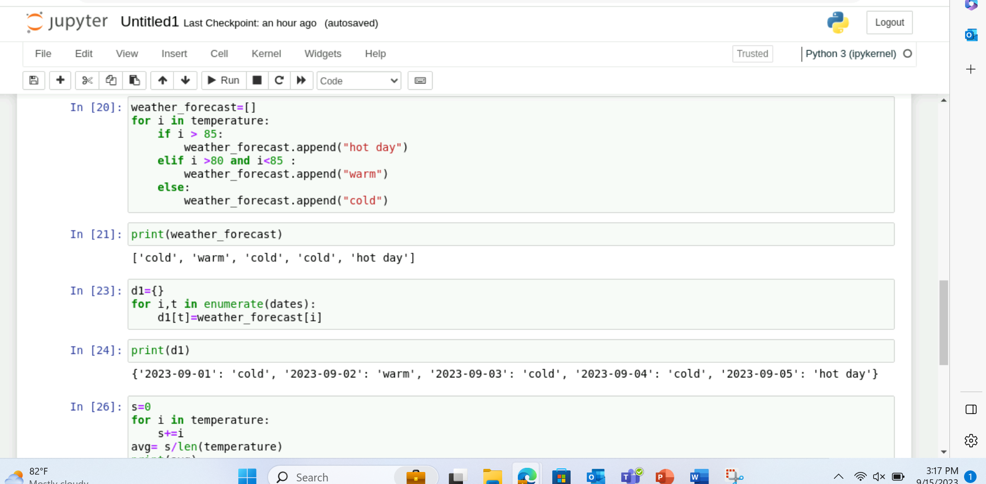

Slide 11
